Slide 1
PnP Community Call – May 2015
aka.ms/OfficeDevPnP
aka.ms/OfficeDevPnPYammer
aka.ms/OfficeDevPnPGuidance
aka.ms/OfficeDevPnPVideos
PnP Core Team

Slide 2

Agenda
Demos, demos, demos
Monthly highlights
Contributions and other topics
Roadmap and next steps

Slide 3
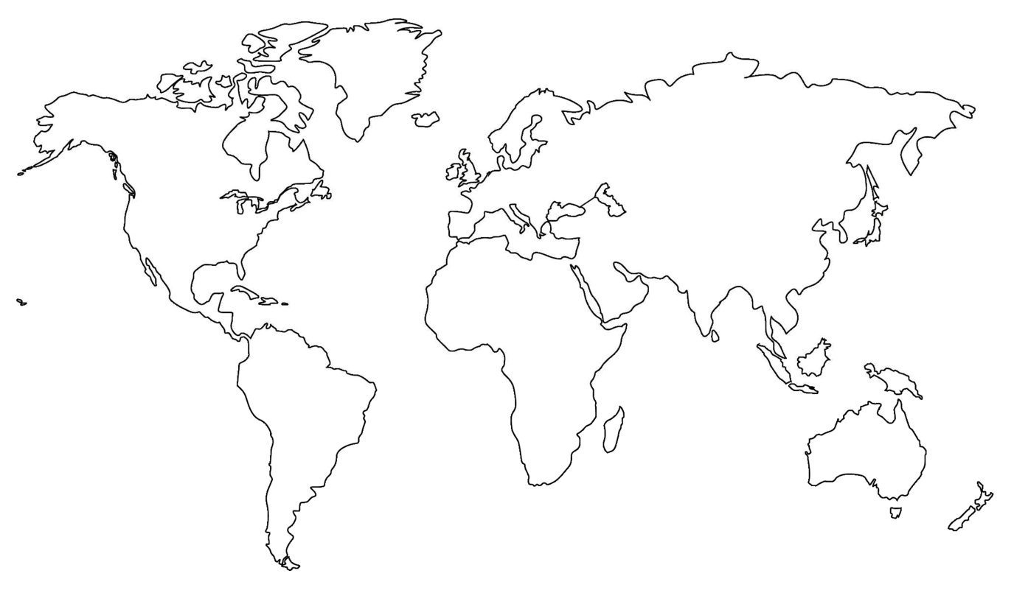
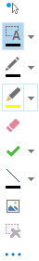
Where are you located?
Stamp Tool
Notes:
Length: 2 minutes for this slide
This slide is a quick demo/practice of the “Stamp” tool and how to use it during course interactions.
Have students Check where they live.
If it’s a small class, have students type their name where they live.
Reach out to the farthest away student

Slide 4

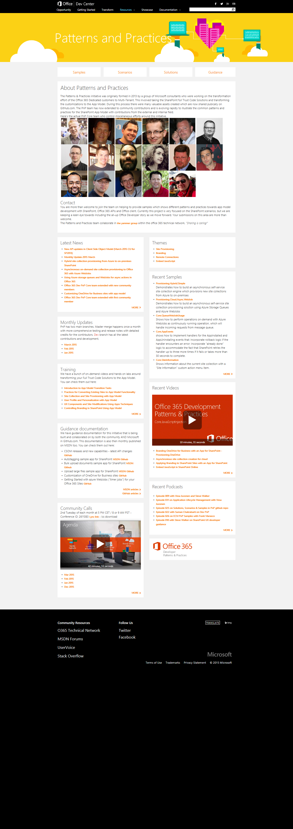
Developer
Patterns & Practices
aka.ms/OfficeDevPnP
aka.ms/OfficeDevPnPYammer
aka.ms/OfficeDevPnPMSDN
aka.ms/OfficeDevPnPVideos
aka.ms/OfficeDevPnPTraining

Slide 5
PnP model
Reusable samples and solutions
Core component
Community
Training
Presentations
PnP
JDP program
Guidance / MSDN
Seminar materials
Videos
Other assets

Slide 6
Statistics– Key numbers (previous month)
Forked 522 times (444, 360, 282, 227, 190, 135)
593 merged/closed pull requests (479, 384, 329, 280, 236, 189)
131 closed issues (122, 101, 73, 67, 58, 43)
More than 4100 (4100, 4100, 3776, 2566, 3050, 2160) unique visitors during last 2 weeks
Nuget package 6004 downloads (5440, 4711, 4450, 4030, 3800)
Yammer group has 2423 members (2251, 2013, 1739, 1525, 1419, 757)
aka.ms/OfficeDevPnPYammer
Facebook page has 194 likes (175, 135, 121)
https://www.facebook.com/OfficeDevPnP

Slide 7
May Release - new contributions
New sample Branding.InjectResponsiveCSS demonstrates how to update out of the box seattle.master user experience responsive without a need to modify the master page as such, but rather to take advantage of the AlternateCssUrl property in Web level
New sample Core.ListRatingSettings lets you enable Social features like Rating/Likes on publishing lists and libraries
New sample Branding.JSLink includes sample re-usable code which demonstrate how you can use the new Client Side Rendering techniques along with JSLink hooks to modify the rendering of List Forms and Views
New sample BusinessApps.ChatRoom shows a method for creating a chat room within a SharePoint web part. The solution uses details from the user's profile to identify the sender of the message and uses SignalR to push messages out to each instance of the chat room

Slide 8
May Release - new contributions
New sample Provisioning.WorkflowTemplate shows how to provision workflow template (.wsp) in on-premises or in Office 365 Dedicated using CSOM. Solution gives you insight how to migrate reusable workflow across site collection and insight how to automate process of deploying and activating reusable workflow packages
New sample Excel.TableBindingFormatting demonstrates techniques for creating a table binding, adding rows to an existing binding, applying table styles and applying cell formatting in an Excel Add-in
New sample Outlook.UpsPackageTracker demonstrates how to create an Add-in for Outlook which extracts data from a mail message, retrieves data from an external service and formats the data for display
New solution Provisioning.Framework.Cloud.Async shows how to build self-service site collection provisioning solution using the Office 365 Developer PnP provisioning engine

Slide 9
May Release - provisioning updates
New provisioning capabilities
Support for the community driven provisioning schema
Improved provider model to allow multiple versions of a formatter
Support for adding pages + adding web parts to pages
Support for site collection managed metadata
DataRow support to add rows during provisioning
Support for lookup columns
Support for taxonomy fields
Support for setting properties on added files
Progress delegate to monitor progress
Fixes for on-premises usage
Performance improvements + smaller enhancements

Slide 10
May release - schema updates
Repository at https://github.com/OfficeDev/PnP-Provisioning-Schema
Objective is to standardize provisioning schema
Site provisioning framework will have adapter model for this standardized xml
Currently 95% there, but small adjsutments to be still applied either on the engine and schema side to fully align the efforts

Slide 11
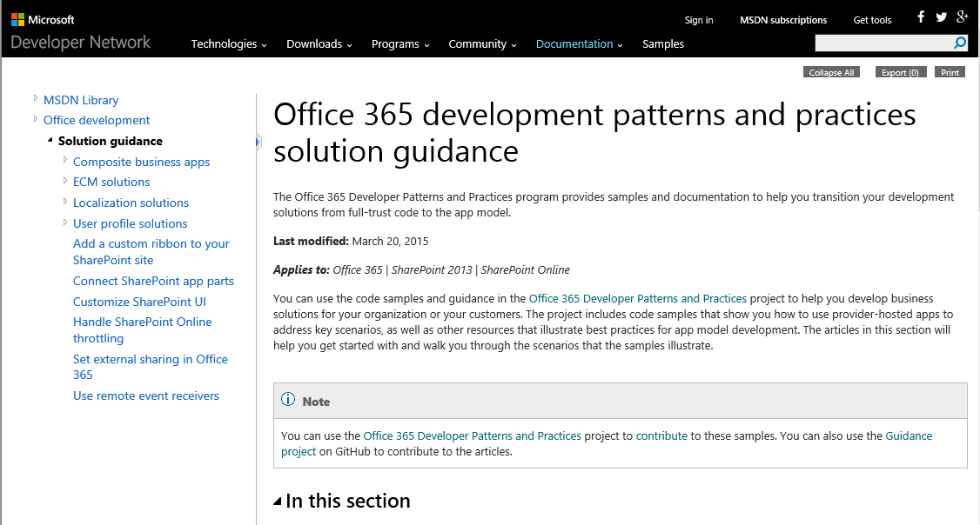
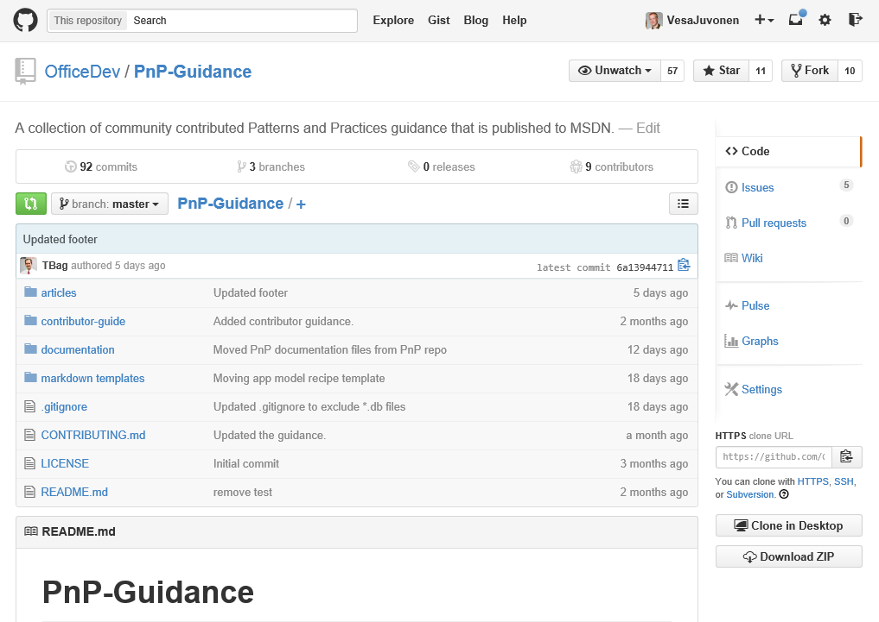
May release - guidance updates
Constant updates based on MSDN articles
New recipes articles gradually being added
Articles as transformation recipes based on the PnP samples and guidance
Injecting JavaScript into SharePoint the safe way
Query SharePoint change log with ChangeQuery and ChangeToken
Transform farm solutions to the SharePoint app model
Authored based on the PnP team input by Todd Baginski
App model recipe - Custom field type
App model recipe - Remote Timer Jobs
App model recipe - Site Columns and Content Types
App model recipe - Site Provisioning
App model recipe - Themes
Guidance – http://aka.ms/OfficeDevPnPGuidance
MSDN– http://aka.ms/OfficeDevPnPMSDN

Slide 12

Thank you for your assistance!
Akhilesh Nirapure (Rapid Circle) - @AkhileshN
Camilo Borges - @camiloborges
Eric Skaggs (http://www.catapultsystems.com) - @skaggej
Erwin van Hunen (Knowit AB) - @erwinvanhunen
Heather Solomon (SharePoint Experts, Inc) - @speheather
Ilker Karimanov
Patrik Björklund (Alloc IT) - @pbjorklund
Paul Schaeflein - @paulschaeflein
Radi Atanassov (OneBit Software) - @RadiAtanassov
Ronald Booden (www.booden.net)
Sly Gryphon (Readify) - @sgryphon
Stefan Bauer (n8d) - @StfBauer
Todd Baginski (Canviz LLC) - @toddbaginski

Slide 13
Thank you for your assistance!
Ivan Vagunin (Knowit AB) - @ivagunin
Ken Domen (Nike.com) - @kendomen
Marat Bakirov - @mbakirov
Martin Hatch (https://www.martinhatch.com) - @MartinHatch
Nanddeep Nachan - @NanddeepNachan
Paolo Pialorsi (PiaSys.com) - @PaoloPia
Torsten Schuster (http://sutor.ws) - @tsc_sutor
Vincent Verbeek (Point 42) - @vverbeek87
Vladimir (OneBit Software)
MS people – Antons Mislevics, Bert Jansen, Brian Michely, Dan Budimir, Doug Perkes, Frank Chen, Frank Marasco, Jeremy Thake, Jonathan Huss, Kiki Shuxteau, Laura Graham, Reeza Ali, Ricky Kirkham, Ron Tielke, Sami Nieminen, Steve Walker, Vesa Juvone

Slide 14

Roadmap – June release plan
Provisioning engine v1.0
Documentation
On-premises testing
Core component v1.x
Continue evolving the Core component
Samples and solutions
Site provisioning UI + reference implementation
Contributions from the field
Transformation IP
Articles
MSDN updates
On-premises App model setup – options and details on the needed configuration
Enterprise architect messaging
ALM
Recipes for transformation
JDP process to be released as reusable package for the field

Slide 15
Feedback…
Please keep the feedback coming in Yammer… we need your input for the prioritization.
Notes:
Priority on planned topics
More code samples
Add core component capabilities
Reusable presentation material
Documentation on patterns and practices for app model (ALM ec.)
More complex solutions
More Office Client apps
More JavaScript app
Length: 30 second for this slide
Instructor notes
The following slides will walk you though the Lync tools that we will use in this class.
You will use all of these tools later in the class
Stress that your students will be able to run much more engaging meetings if they use these tools in their own Lync Meetings.
Course Development Notes:

Slide 16

Demos, demos, demos!
Martin Hatch – JSLinks customization
What is it and how does it work
Doug Perkes – Office Add-Ins
What is it and how does it work
(optional if time permits)
Bert – Adding response design to a team site

Slide 17
Transform your code Providing App Model Patterns for common Full Trust Code scenarios
130+ Visual Studio projects Common scenarios
Branding
Site provisioning
Remote event receivers
Large file support
Taxonomy driven navigation
And much more…
Contribute
This is open source project and open for contirbutions
Developer
Patterns & Practices
aka.ms/OfficeDevPnP

Slide 18

Questions?

Slide 19


© 2014 Microsoft Corporation. All rights reserved. Microsoft, Windows, and other product names are or may be registered trademarks and/or trademarks in the U.S. and/or other countries.
The information herein is for informational purposes only and represents the current view of Microsoft Corporation as of the date of this presentation. Because Microsoft must respond to changing market conditions, it should not be interpreted to be a commitment on the part of Microsoft, and Microsoft cannot guarantee the accuracy of any information provided after the date of this presentation. MICROSOFT MAKES NO WARRANTIES, EXPRESS, IMPLIED OR STATUTORY, AS TO THE INFORMATION IN THIS PRESENTATION.

